Slide 1
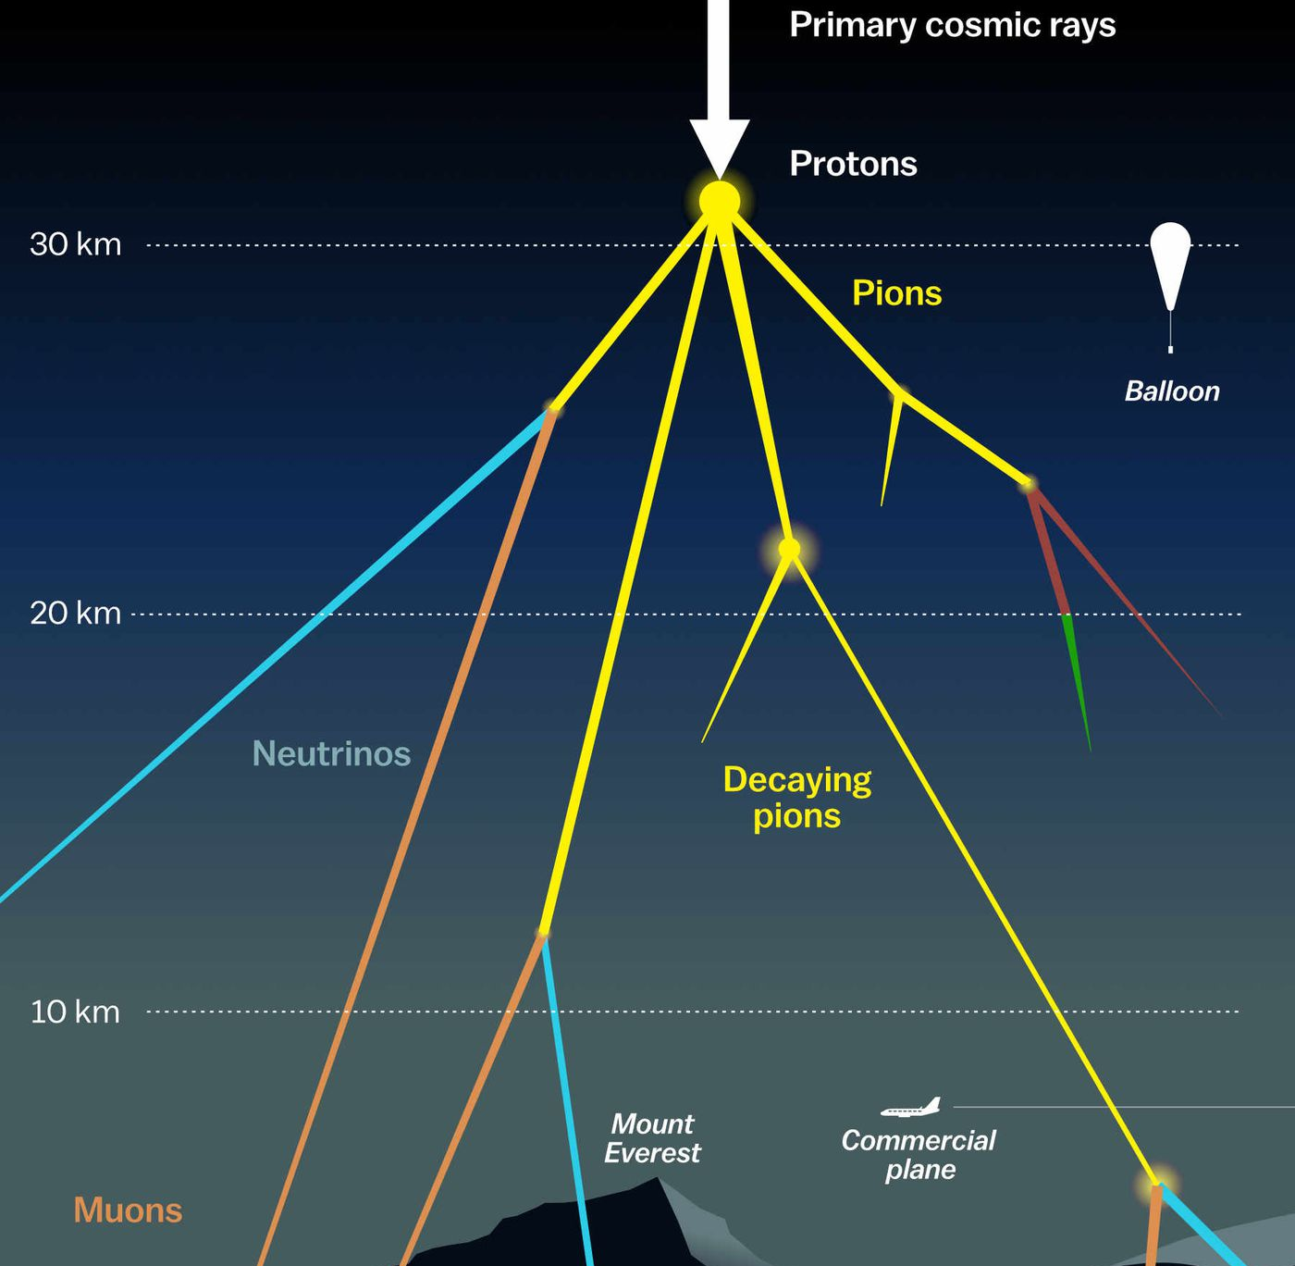
Measuring the prompt component of the atmospheric muon flux Ludwig Neste and Pascal Gutjahr
F3/F4 Meeting
Dortmund 2023
https://www.vox.com/the-highlight/2019/7/16/17690740/cosmic-rays-universe-theory-science

Slide 2

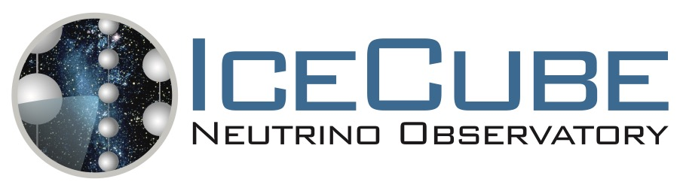

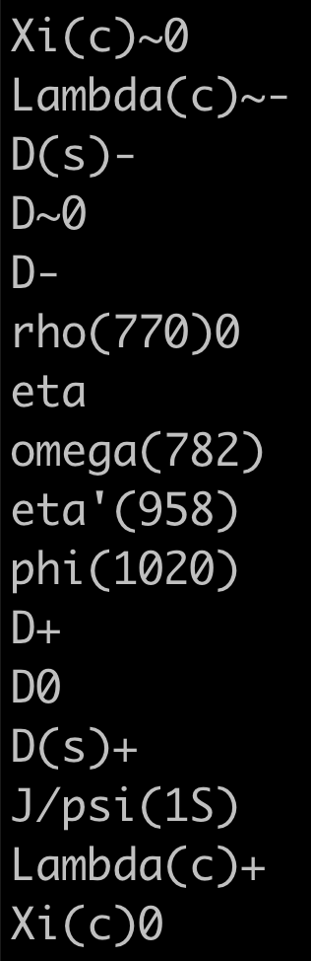
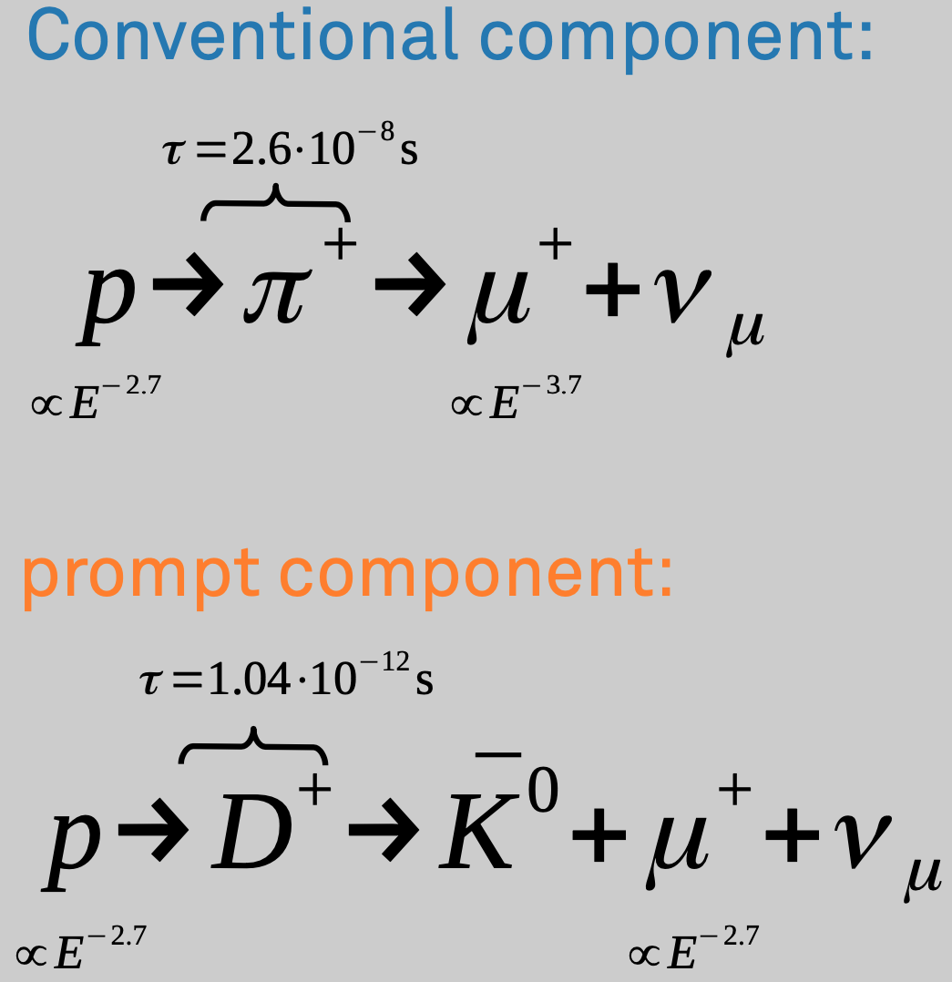

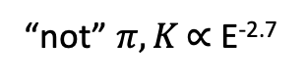
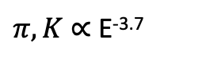
Definition of the muon flux
$φ_{tot}=φ_{conventional}+φ_{prompt}$
$π, Κ$ ∝ E^{-3.7}
“not” $π, Κ \text{∝ }\text{E}\text{−}\text{2}\text{.7}$

Slide 3
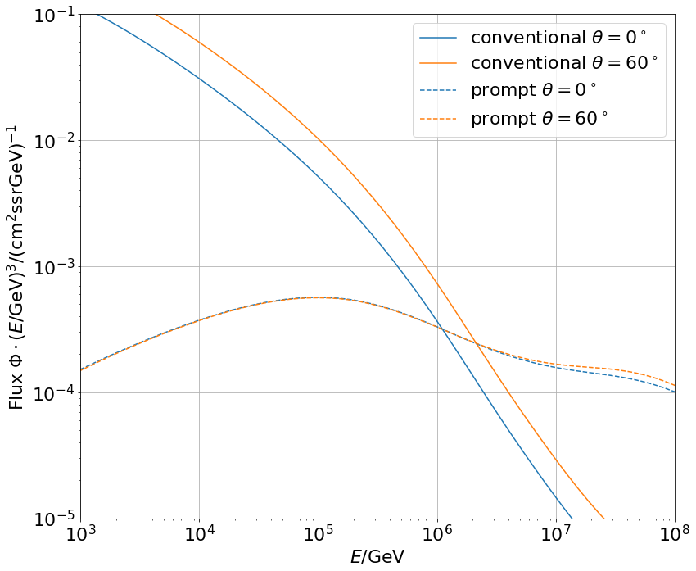
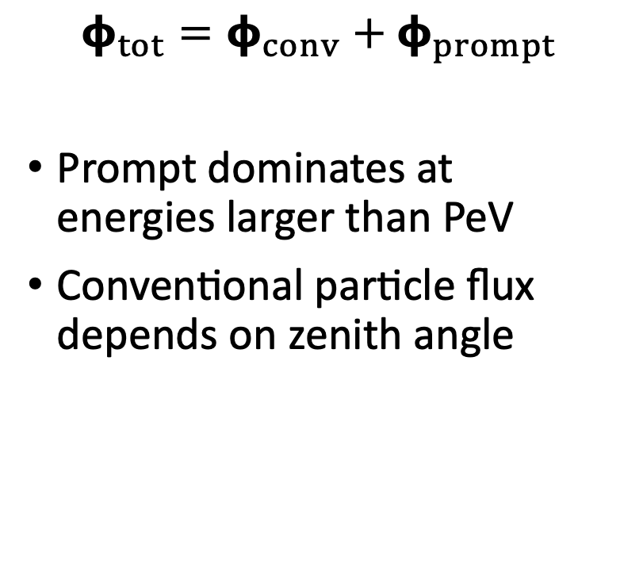
Muon flux
0°: perpendicular to Earth’s surface
$$φ_{tot}=φ_{conv}+φ_{prompt}$$
Prompt dominates at energies larger than PeV
Conventional particle flux depends on zenith angle
conventional
prompt
We can measure prompt muon energies from ~1 PeV to ~100 PeV

Slide 4
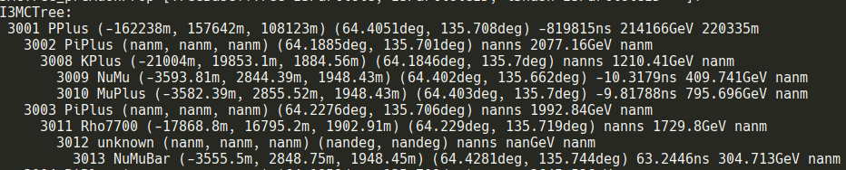
Ideas to measure the prompt component
CORSIKA 7
SIBYLL 2.3d → charm included
Use extended history option in CORSIKA → parent information
Tag muon parent particles in MC (prompt/conv)
Scale amount of prompt particles to create several datasets
Fit of prompt flux normalization
Get handle on hadronic interaction models
Scaling saves time and resources instead of doing multiple simulations with different interaction models
Analyze:
Muon energy
Zenith angle
Time (seasonal variations)
Conventional flux depends on the season
First simulations produced

Slide 5
Identify prompt particles in air shower
Good agreement between CORSIKA and MCEq in total
Mismatches between the production of D_{s} and D₀
MCEq: tool to numerically solve the cascade equations that describe the evolution of particle densities as they propagate through gaseous a dense medium
https://github.com/mceq-project/MCEq

Slide 6
Scaling of the prompt component (sketch)
Amount of prompt particles is re-weighted with 0.5 and 2
Use tagging of prompt in CORSIKA MC
Conventional component is not much affected
If a shower contains prompt, almost no conv. particles in the shower arrive at the surface
Used for likelihood fit

Slide 7
Summary
CORSIKA 7 with SIBYLL 2.3d
Tag muon parents
Good agreement with MCEq in total, but mismatch in D_{s} and D₀
We will provide:
Normalization of the prompt muon flux in dependence of muon energy and zenith angle
Unfolding at Earth’s surface
Future discussion:
How to extract physical parameters from effective scaling?
branching ratios (BR), cross-sections, particle physics
Scale BR and hadronic models compatible with LHC results
Thank you for your attention ☺️ pascal.gutjahr@tu-dortmund.de

Slide 8
Backup

Slide 9
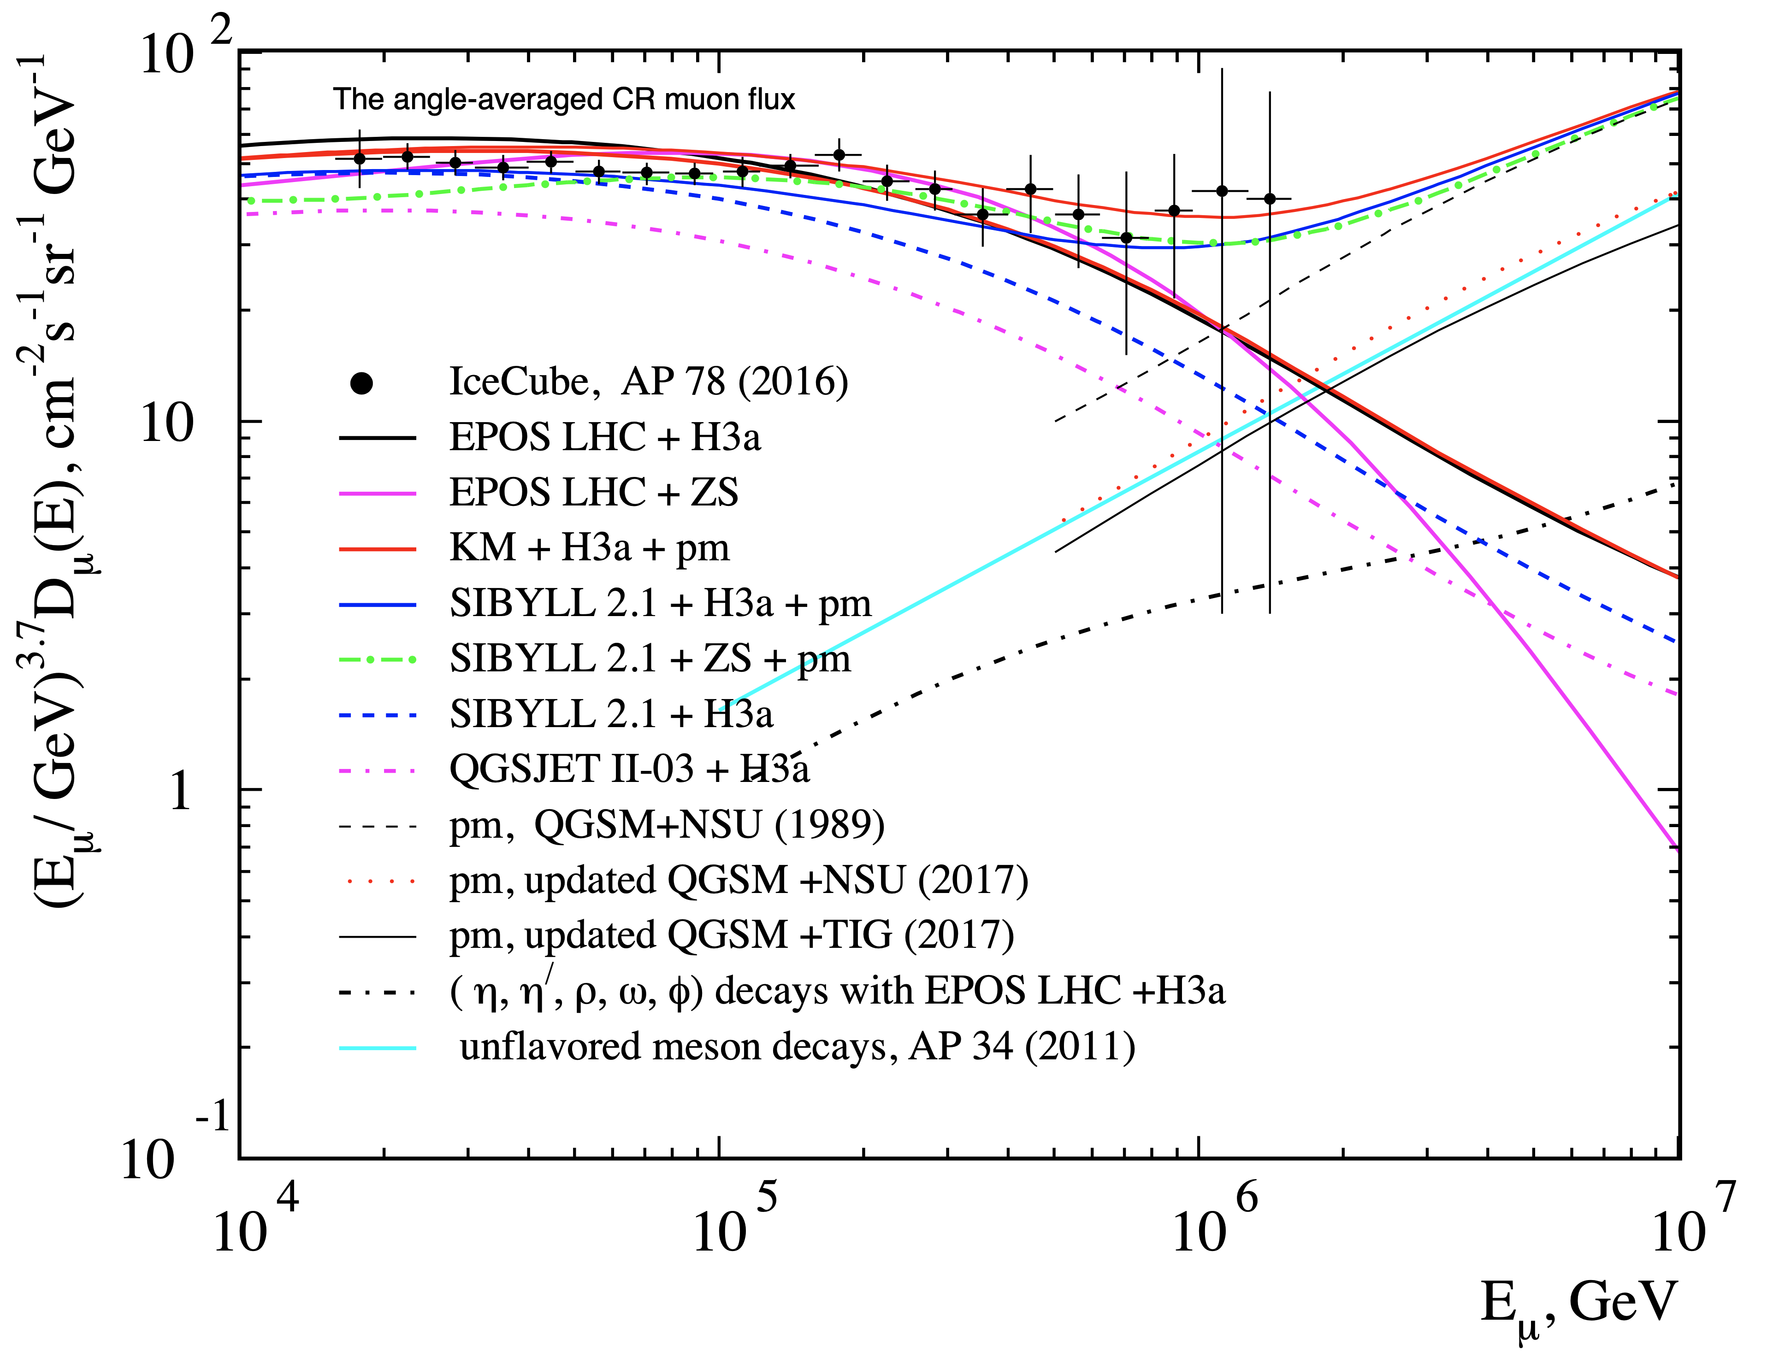
Observations
Mismatch between data and hadronic interaction models
No charm included in the past
Prompt was neglected
Fits better by adding prompt model
New simulations including charm
[Journal of Physics: Conf. Series. 2019. V. 1181, 012054]

Slide 10
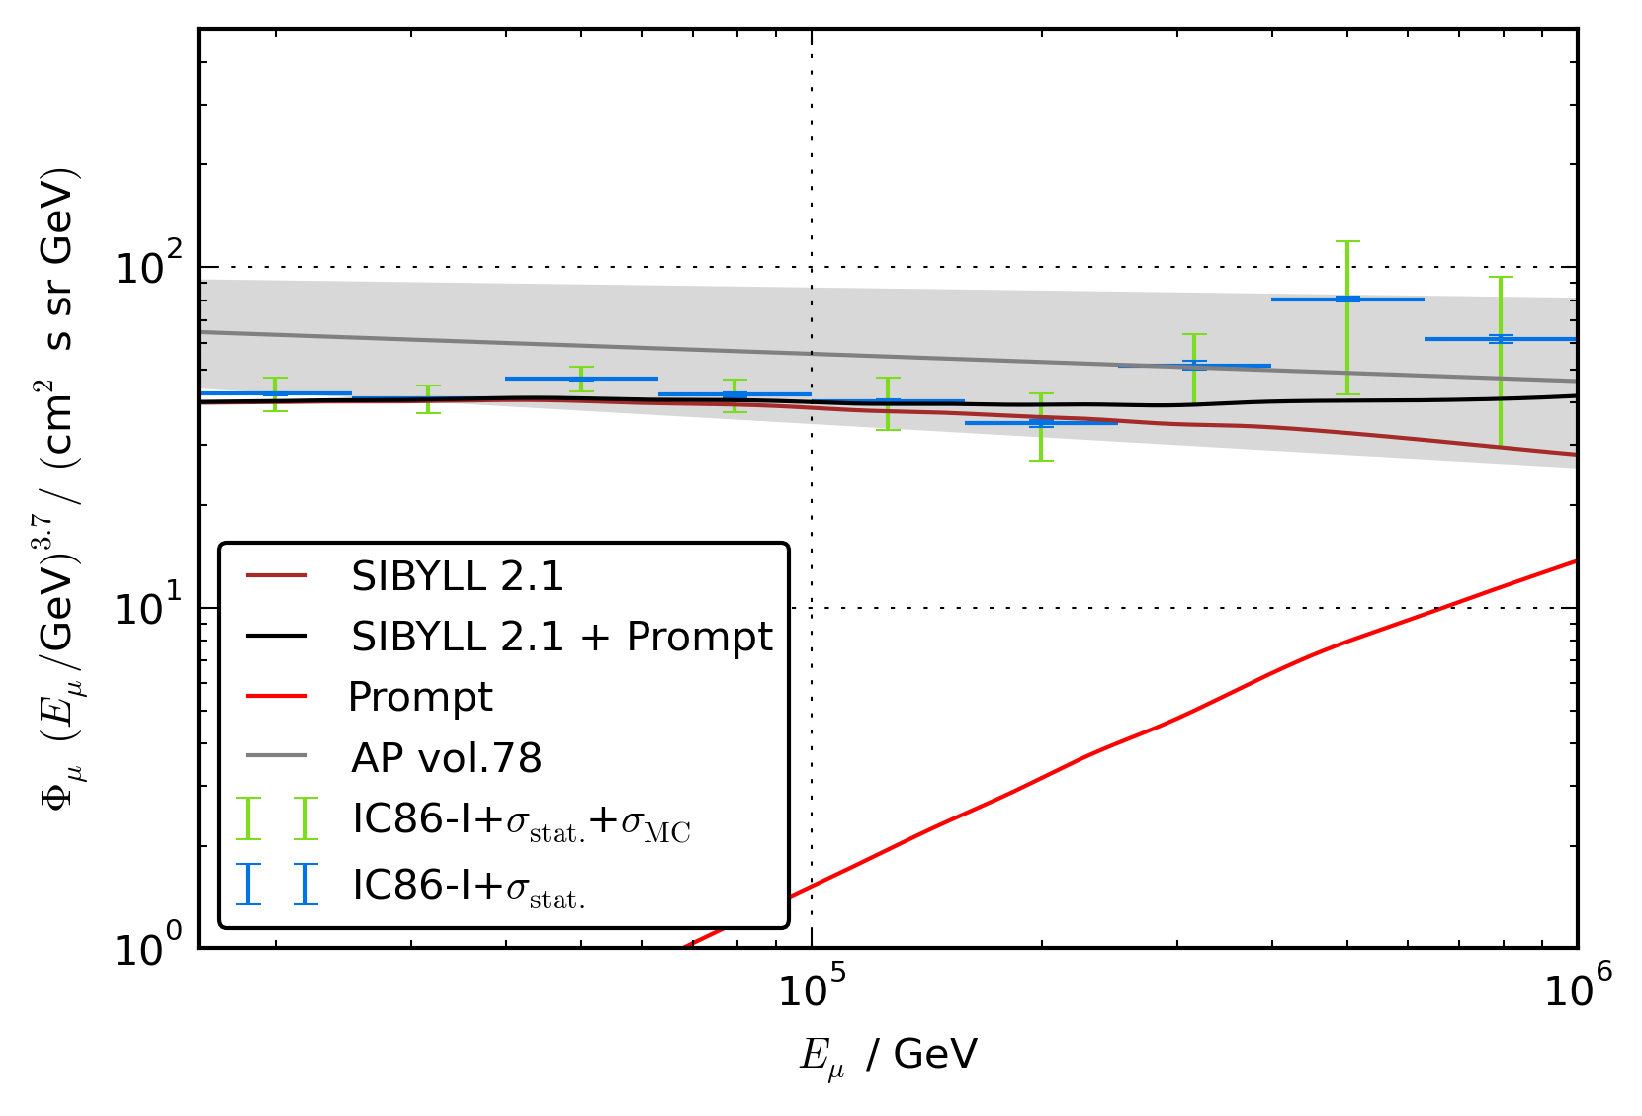
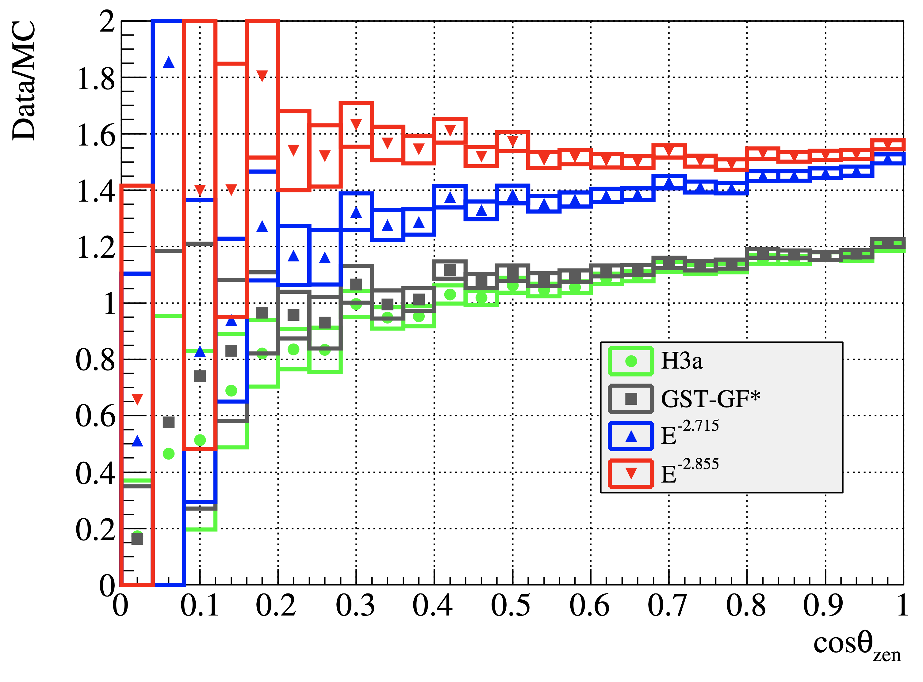
Previous analyses
Fit compatible with zero
MC uncertainties too large
Results promising, but zenith problem
[T. Fuchs, PhD Thesis, 10.17877/DE290R-17241]
[IceCube Collaboration, Astroparticle Physics, 10.1016/j.astropartphys.2016.01.006]

Slide 11
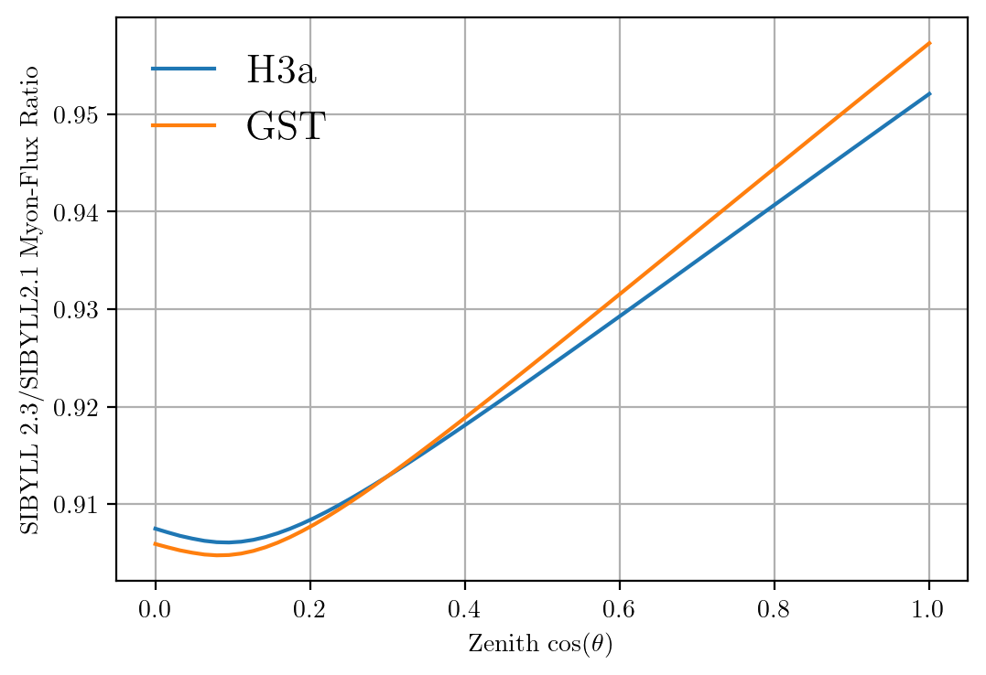
Solution to zenith problem?
No complete solution, but a step in the right direction

Slide 12
Muon energy distributions
Highest energetic muon per shower/tree inside detector is shown
Too less statistics at high energies
Unknown: parent particle is not known → generation counter indicates, that there are particles between mother and muon → conventional

Slide 13
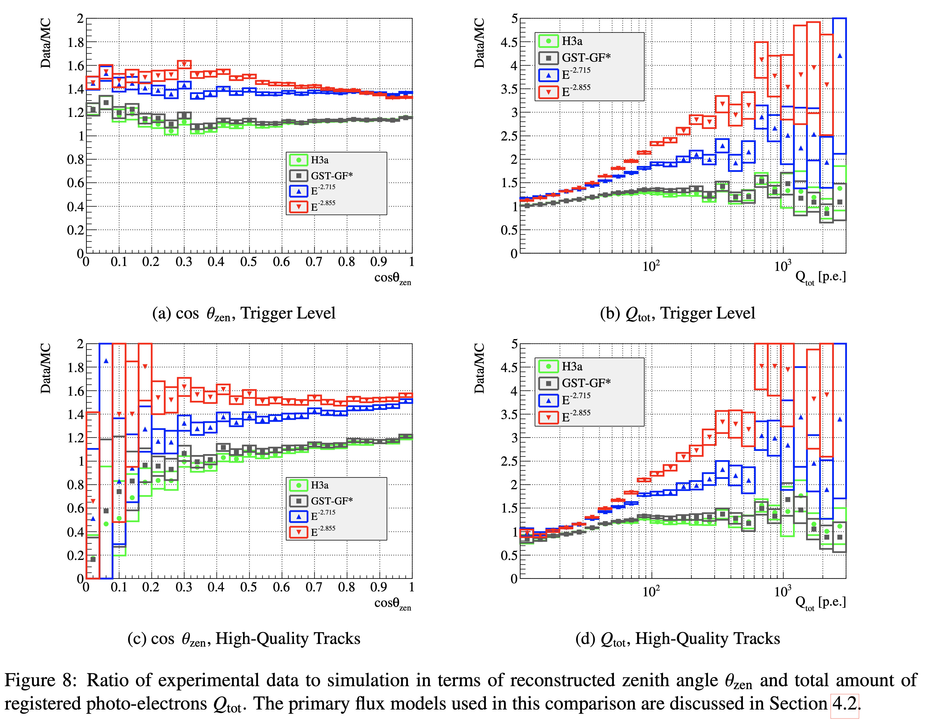
Backup: Zenith problem

Slide 14
Specific parent particle identification
CORSIKA 7 using SIBYLL 2.3d vs. SIBYLL 2.3c¹
Good agreement with unflavored particles
Mismatches occur for all the D-mesons
Issue not yet solved
Only protons simulated with CORSIKA
¹ Phys. Rev. D 100 (2019) 103018

Slide 15
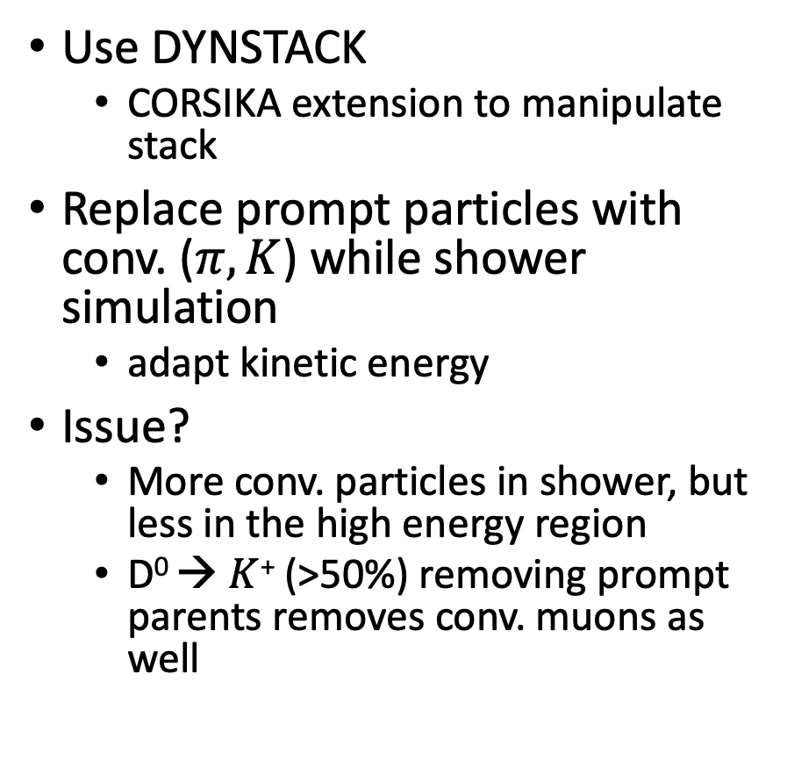
Backup: Scaling of the prompt component - DYNSTACK
Use DYNSTACK
CORSIKA extension to manipulate stack
Replace prompt particles with conv. ($π,Κ$) while shower simulation
adapt kinetic energy
Issue?
More conv. particles in shower, but less in the high energy region
D⁰ → $Κ$⁺ (>50%) removing prompt parents removes conv. muons as well

